Slide 1
Continuous Control with Deep Reinforcement Learning

Slide 2
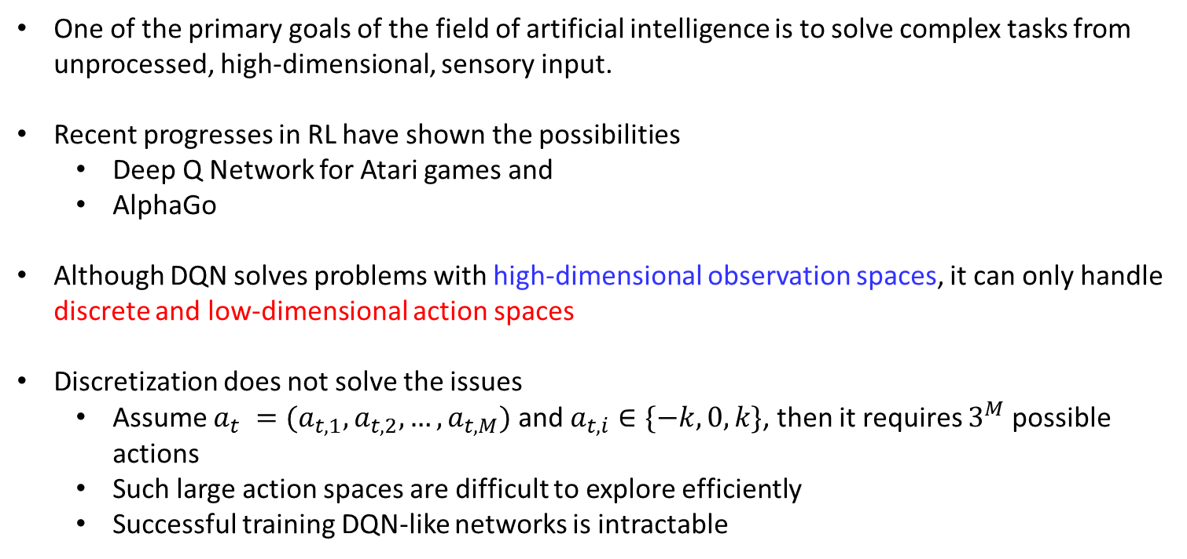
Motivation
One of the primary goals of the field of artificial intelligence is to solve complex tasks from unprocessed, high-dimensional, sensory input.
Recent progresses in RL have shown the possibilities
Deep Q Network for Atari games and
AlphaGo
Although DQN solves problems with high-dimensional observation spaces, it can only handle discrete and low-dimensional action spaces
Discretization does not solve the issues
Assume $a_{t} =(a_{t,1},a_{t,2},…,a_{t,M})$ and $a_{t,i}∈\{−k,0,k\}$, then it requires $3^{M}$ possible actions
Such large action spaces are difficult to explore efficiently
Successful training DQN-like networks is intractable

Slide 3

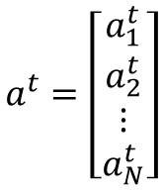
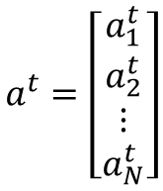

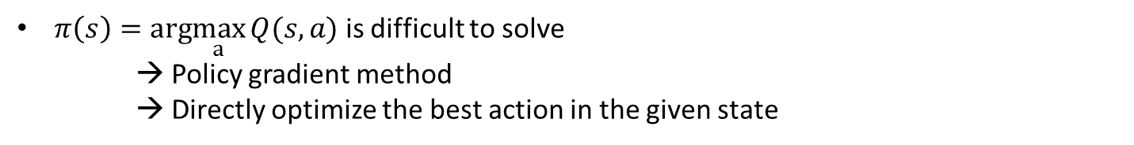

Motivation
Assume the action at time is a profile of the actions of $N$ agents:
$$a^{t}=\left[\begin{aligned}a_{1}^{t} \\ a_{2}^{t} \\ ⋮ \\ a_{N}^{t}\end{aligned}\right]$$
If $a_{i}^{t}∈\{1, …,K\}$
$$\left|a^{t}\right|=K^{N}$$
Treat each action is continuous value to relax cardinality issue
$$a^{t}=\left[\begin{aligned}a_{1}^{t} \\ a_{2}^{t} \\ ⋮ \\ a_{N}^{t}\end{aligned}\right]$$
If $a_{i}^{t}∈[0,K]$
Now, our action is a $N$-dimensional vector $a^{t}∈ℝ^{N}$
$π\left(s\right)=arg\max_{a}{Q(s,a)}$ is difficult to solve
→ Policy gradient method
→ Directly optimize the best action in the given state

Slide 4
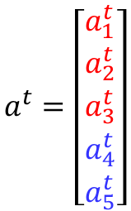
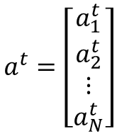






Motivation
$$a^{t}=\left[\begin{aligned}a_{1}^{t} \\ a_{2}^{t} \\ a_{3}^{t} \\ a_{4}^{t} \\ a_{5}^{t}\end{aligned}\right]$$
$$a^{t}=\left[\begin{aligned}a_{1}^{t} \\ a_{2}^{t} \\ ⋮ \\ a_{N}^{t}\end{aligned}\right]$$
If $a_{i}^{t}∈[0,K]$
$$1$$
$$2$$
$a_{1}^{t}$: The cell that digger $1$ need to excavate
$a_{4}^{t}$: The soil that mover $4$ need to dump away
$$K$$
Discrete→ continuous→ discrete

Slide 5
Goals
Continuous Control with Deep Reinforcement Learning
Lillicrap et al., (2016) google.com
Develop a model-free, off-policy actor-critic algorithm using deep function approximators that can learn policies in high-dimensional, continuous action spaces
It combines three components:
Actor-critic algorithm (Sutton et al., 1999)
Deep Q Network (Mnih et al, 2015)
Deterministic Policy Gradient (Silver 2015)

Slide 6
Actor-Critic Method
Value function
Policy
Actor
Critic
Value based
Policy-Based

Slide 7
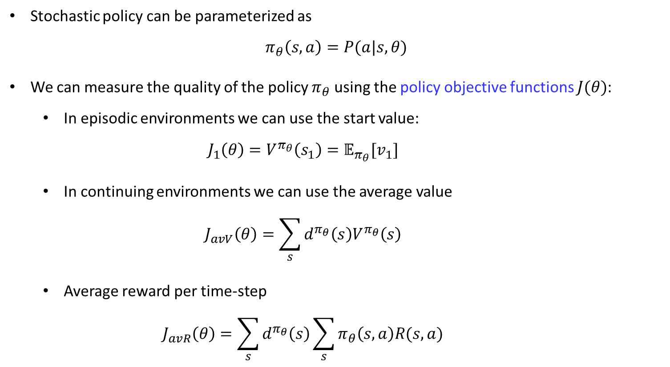
Policy Objective Function
Stochastic policy can be parameterized as
$$π_{θ}\left(s,a\right)=P(a|s,θ)$$
We can measure the quality of the policy $π_{θ}$ using the policy objective functions $J(θ)$:
In episodic environments we can use the start value:
$$J_{1}\left(θ\right)=V^{π_{θ}}\left(s_{1}\right)=𝔼_{π_{θ}}[v_{1}]$$
In continuing environments we can use the average value
$$J_{avV}\left(θ\right)=\sum_{s}{d^{π_{θ}}\left(s\right)V^{π_{θ}}\left(s\right)}$$
Average reward per time-step
$$J_{avR}\left(θ\right)=\sum_{s}{d^{π_{θ}}\left(s\right)\sum_{s}{π_{θ}\left(s,a\right)R(s,a)}}$$
$d^{π_{θ}}\left(s\right)$ is stationary distribution of Markov chain for $π_{θ}$

Slide 8
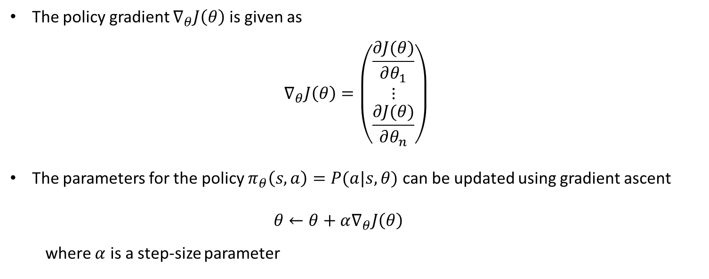
Policy Gradient
The policy gradient $∇_{θ}J\left(θ\right)$ is given as
$$∇_{θ}J\left(θ\right)=\left(\begin{aligned}\frac{∂J(θ)}{∂θ_{1}} \\ ⋮ \\ \frac{∂J(θ)}{∂θ_{n}}\end{aligned}\right)$$
The parameters for the policy $π_{θ}\left(s,a\right)=P(a|s,θ)$ can be updated using gradient ascent
$$θ←θ+α∇_{θ}J\left(θ\right)$$
where $α$ is a step-size parameter

Slide 9
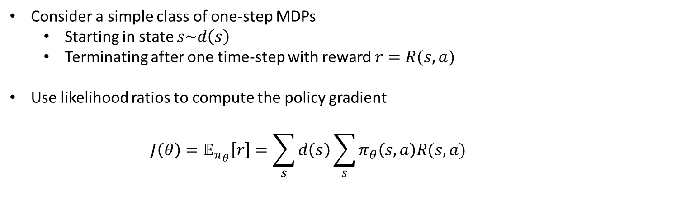
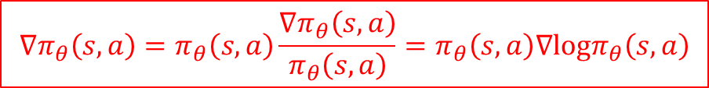
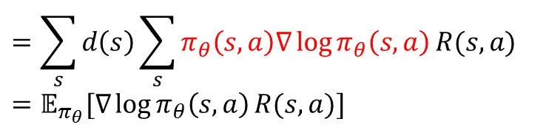
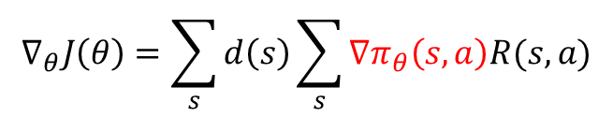
Policy Gradient Theorem (Stochastic policy)
Consider a simple class of one-step MDPs
Starting in state $s\sim d\left(s\right)$
Terminating after one time-step with reward $r=R(s,a)$
Use likelihood ratios to compute the policy gradient
$$J\left(θ\right)=𝔼_{π_{θ}}\left[r\right]=\sum_{s}{d\left(s\right)\sum_{s}{π_{θ}\left(s,a\right)R(s,a)}}$$
$$∇_{θ}J\left(θ\right)=\sum_{s}{d\left(s\right)\sum_{s}{∇π_{θ}\left(s,a\right)R(s,a)}}$$
$$=\sum_{s}{d\left(s\right)\sum_{s}{π_{θ}\left(s,a\right)∇\log{π_{θ}\left(s,a\right)}R(s,a)}}$$
$$=𝔼_{π_{θ}}[∇\log{π_{θ}\left(s,a\right)}R(s,a)]$$
$$∇π_{θ}\left(s,a\right)=π_{θ}\left(s,a\right)\frac{∇π_{θ}\left(s,a\right)}{π_{θ}\left(s,a\right)}=π_{θ}\left(s,a\right)∇logπ_{θ}\left(s,a\right)$$

Slide 10
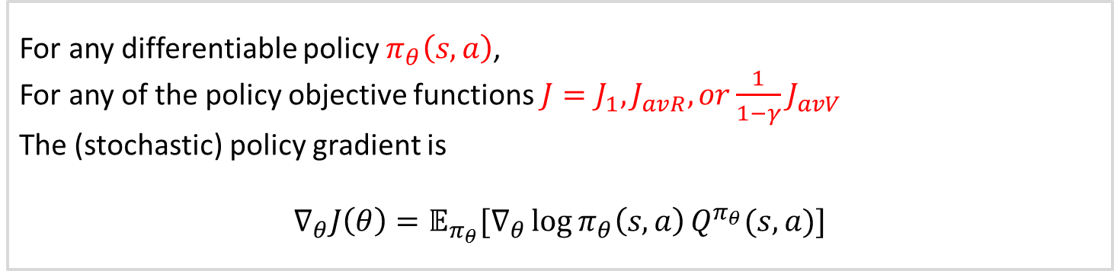
Policy Gradient Theorem (Stochastic policy)
Theorem
For any differentiable policy $π_{θ}\left(s,a\right)$,
For any of the policy objective functions $J=J_{1},J_{avR}, or\frac{1}{1−γ}J_{avV}$
The (stochastic) policy gradient is
$$∇_{θ}J\left(θ\right)=𝔼_{π_{θ}}[∇_{θ}\log{π_{θ}\left(s,a\right)}Q^{π_{θ}}(s,a)]$$
Expectation over (state and action)
Policy gradient is (score function)$×$(action-value function)

Slide 11
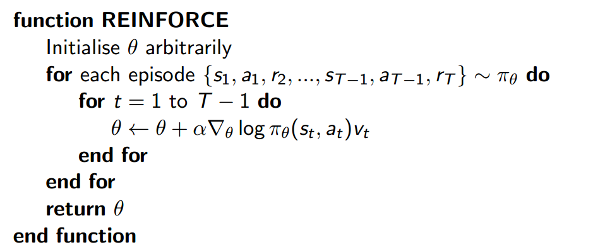
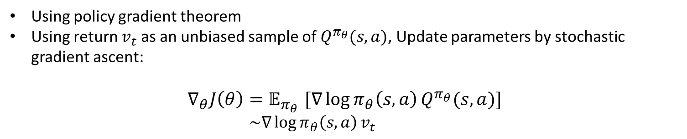

Monte-Carlo Policy Gradient (Reinforce)
Using policy gradient theorem
Using return $v_{t}$ as an unbiased sample of $Q^{π_{θ}}(s,a)$, Update parameters by stochastic gradient ascent:
$$∇_{θ}J\left(θ\right){=𝔼}_{π_{θ}}[∇\log{π_{θ}\left(s,a\right)}Q^{π_{θ}}(s,a)]$$
$$\sim ∇\log{π_{θ}\left(s,a\right)}v_{t}$$
$$Δθ_{t}=α∇\log{π_{θ}\left(s,a\right)}v_{t}$$

Slide 12
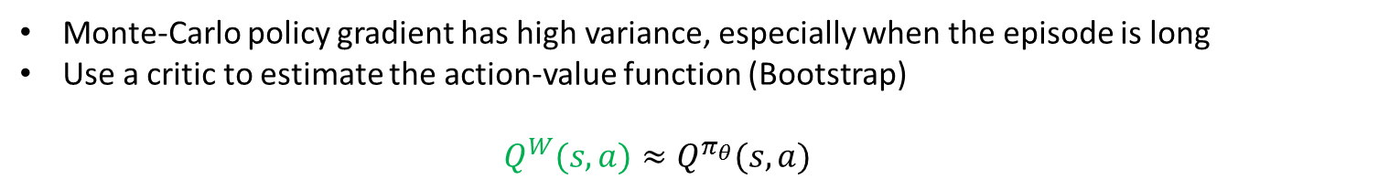
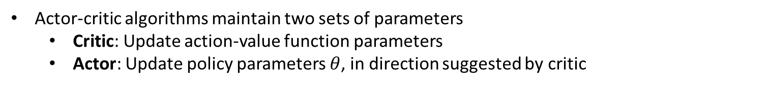

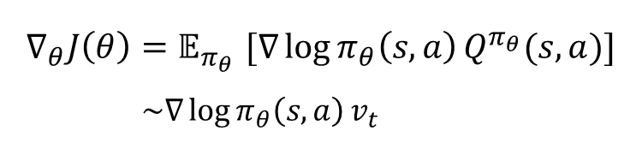
Reducing Variance Using a Critic
Monte-Carlo policy gradient has high variance, especially when the episode is long
Use a critic to estimate the action-value function (Bootstrap)
$$Q^{W}(s,a)≈Q^{π_{θ}}(s,a)$$
Actor-critic algorithms follow an approximate policy gradient:
$$∇_{θ}J\left(θ\right){=𝔼}_{π_{θ}}[∇\log{π_{θ}\left(s,a\right)}Q^{π_{θ}}(s,a)]$$
$$\sim ∇\log{π_{θ}\left(s,a\right)}v_{t}$$
(Sample trajectory)
$$\sim ∇\log{π_{θ}\left(s,a\right)}Q^{W}(s,a)$$
(Bootstrap)
Actor-critic algorithms maintain two sets of parameters
Critic: Update action-value function parameters
Actor: Update policy parameters $θ$, in direction suggested by critic

Slide 13
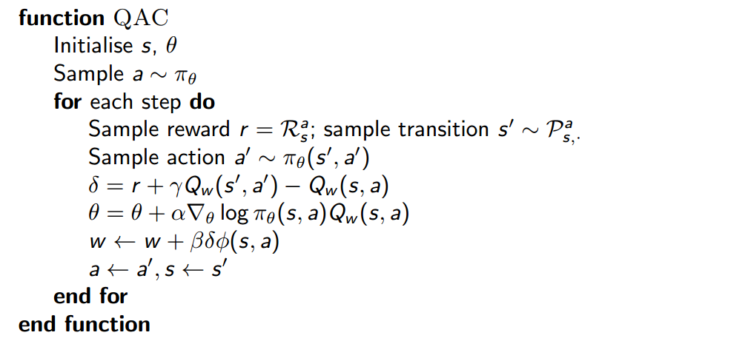
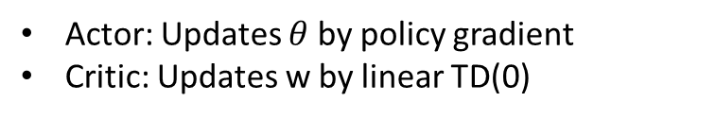
Actor-Critic Algorithm
Actor: Updates $θ$ by policy gradient
Critic: Updates w by linear TD(0)

Slide 14
Compatible Function Approximation Theorem

Slide 15
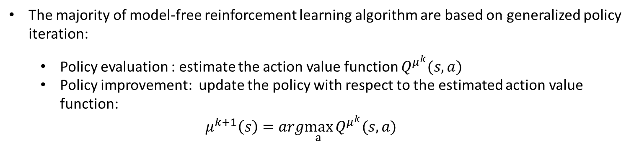
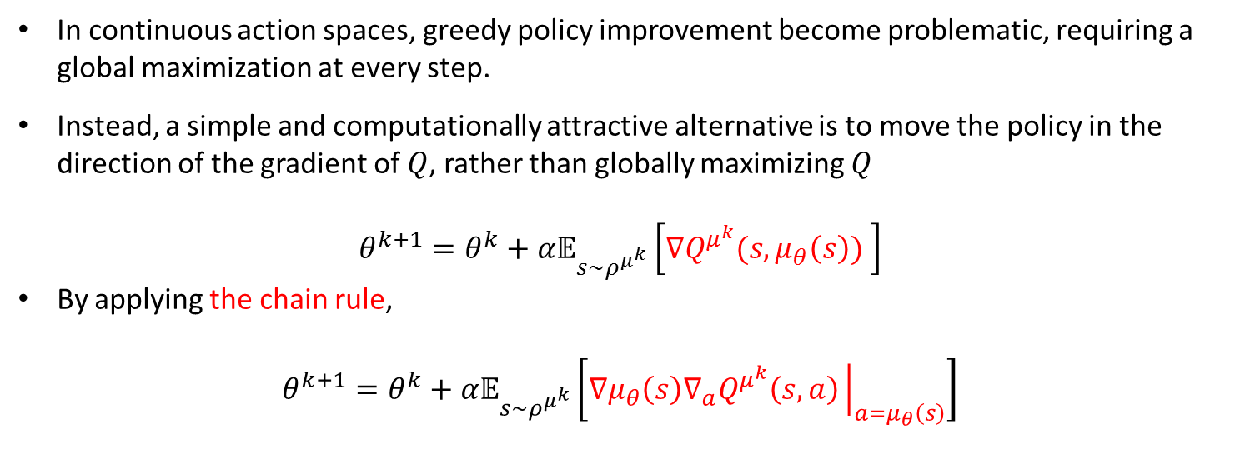
Deterministic Policy Gradient
Motivation
The majority of model-free reinforcement learning algorithm are based on generalized policy iteration:
Policy evaluation : estimate the action value function $Q^{μ^{k}}(s,a)$
Policy improvement: update the policy with respect to the estimated action value function:
$$μ^{k+1}\left(s\right)=arg\max_{a}{Q^{μ^{k}}(s,a)}$$
In continuous action spaces, greedy policy improvement become problematic, requiring a global maximization at every step.
Instead, a simple and computationally attractive alternative is to move the policy in the direction of the gradient of $Q$, rather than globally maximizing $Q$
$$θ^{k+1}=θ^{k}+α𝔼_{s\sim ρ^{μ^{k}}}\left[∇Q^{μ^{k}}(s,μ_{θ}\left(s\right)) \right]$$
By applying the chain rule,
$$θ^{k+1}=θ^{k}+α𝔼_{s\sim ρ^{μ^{k}}}\left[∇μ_{θ}\left(s\right)∇_{a}Q^{μ^{k}}\left(s,a\right){\left.​\right|}_{a=μ_{θ}\left(s\right)}\right]$$

Slide 16
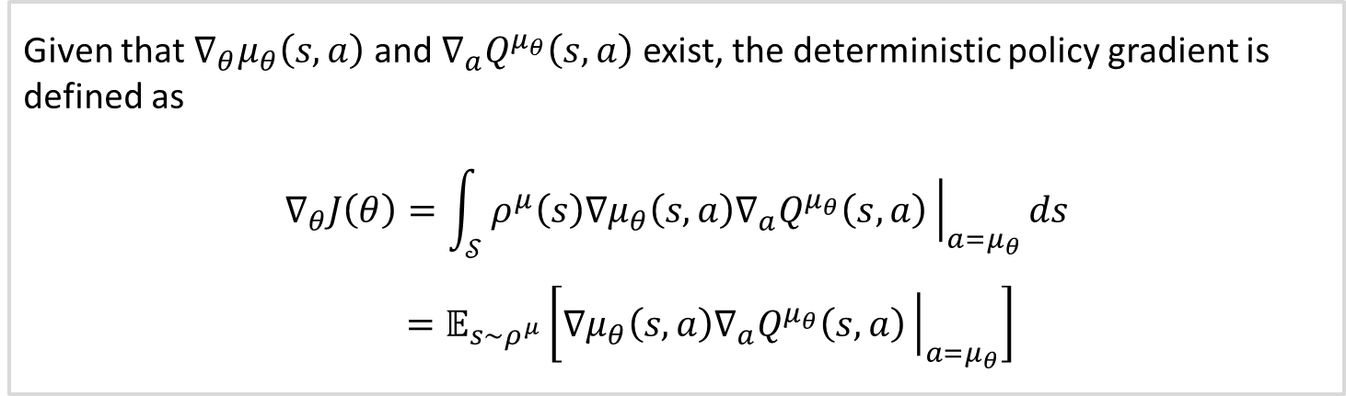
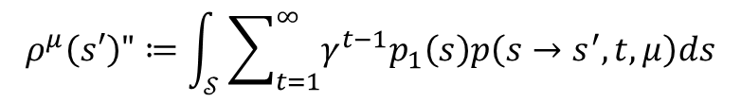
Deterministic Policy Gradient
Theorem (Deterministic policy gradient)
Given that $∇_{θ}μ_{θ}\left(s,a\right)$ and ${∇_{a}Q}^{μ_{θ}}\left(s,a\right)$ exist, the deterministic policy gradient is defined as
$$∇_{θ}J\left(θ\right)=\int_{𝒮}^{ }{ρ^{μ}\left(s\right)∇μ_{θ}\left(s,a\right){∇_{a}Q}^{μ_{θ}}\left(s,a\right){\left.​\right|}_{{a=μ}_{θ}}ds}$$
$$=𝔼_{s\sim ρ^{μ}}\left[∇μ_{θ}\left(s,a\right){∇_{a}Q}^{μ_{θ}}\left(s,a\right){\left.​\right|}_{{a=μ}_{θ}}\right]$$
$$ρ^{μ}\left(s′\right)"≔\int_{𝒮}^{ }{\sum_{t=1}^{∞}{γ^{t−1}p_{1}\left(s\right)p\left(s→s^{′}, t, μ\right)ds}}$$

Slide 17
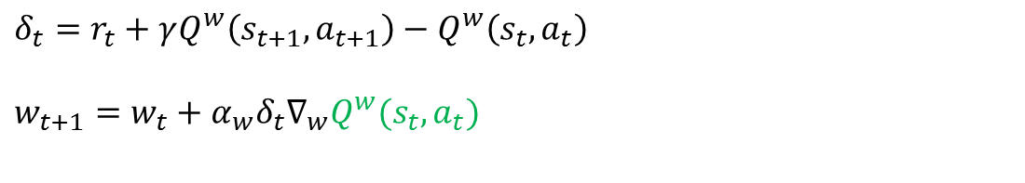
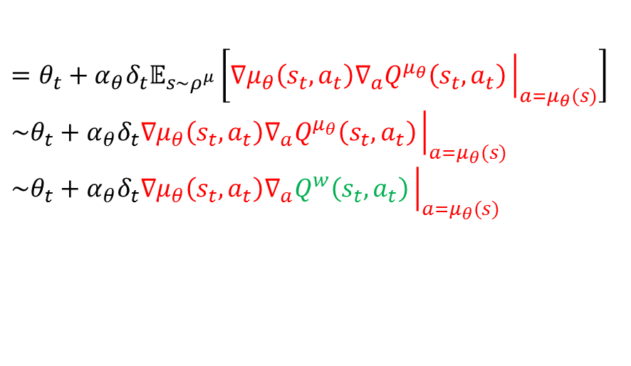

Deterministic Actor-Critic Algorithms
On-policy Deterministic Actor-Critic Method (SARSA)
$$δ_{t}=r_{t}+γQ^{w}\left(s_{t+1}, a_{t+1}\right)−Q^{w}\left(s_{t}, a_{t}\right)$$
$$w_{t+1}=w_{t}+α_{w}δ_{t}∇_{w}Q^{w}(s_{t},a_{t})$$
$$θ_{t+1}=θ_{t}+α_{θ}δ_{t}∇_{θ}J\left(θ\right)$$
$$=θ_{t}+α_{θ}δ_{t}𝔼_{s\sim ρ^{μ}}\left[∇μ_{θ}\left(s_{t},a_{t}\right){∇_{a}Q}^{μ_{θ}}\left(s_{t},a_{t}\right){\left.​\right|}_{{a=μ}_{θ}(s)}\right]$$
$$\sim θ_{t}+α_{θ}δ_{t}∇μ_{θ}\left(s_{t},a_{t}\right){∇_{a}Q}^{μ_{θ}}\left(s_{t},a_{t}\right){\left.​\right|}_{{a=μ}_{θ}(s)}$$
$$\sim θ_{t}+α_{θ}δ_{t}∇μ_{θ}\left(s_{t},a_{t}\right){∇_{a}Q}^{w}\left(s_{t},a_{t}\right){\left.​\right|}_{{a=μ}_{θ}(s)}$$
Stochastic ascent
Use Critic

Slide 18
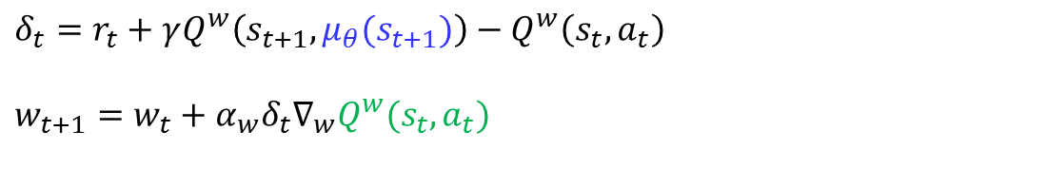
Deterministic Actor-Critic Algorithms
Off-policy Deterministic Actor-Critic Method (SARSA)
Learn a deterministic target policy $μ_{θ}(s)$ from trajectories generated by an arbitrary stochastic behavior policy
$$δ_{t}=r_{t}+γQ^{w}\left(s_{t+1},μ_{θ}(s_{t+1})\right)−Q^{w}\left(s_{t}, a_{t}\right)$$
$$w_{t+1}=w_{t}+α_{w}δ_{t}∇_{w}Q^{w}(s_{t},a_{t})$$
$$θ_{t+1}=θ_{t}+α_{θ}δ_{t}∇_{θ}J\left(θ\right)$$
$$=θ_{t}+α_{θ}δ_{t}𝔼_{s\sim ρ^{μ}}\left[∇μ_{θ}\left(s_{t},a_{t}\right){∇_{a}Q}^{μ_{θ}}\left(s_{t},a_{t}\right){\left.​\right|}_{{a=μ}_{θ}(s)}\right]$$
$$\sim θ_{t}+α_{θ}δ_{t}∇μ_{θ}\left(s_{t},a_{t}\right){∇_{a}Q}^{μ_{θ}}\left(s_{t},a_{t}\right){\left.​\right|}_{{a=μ}_{θ}(s)}$$
$$\sim θ_{t}+α_{θ}δ_{t}∇μ_{θ}\left(s_{t},a_{t}\right){∇_{a}Q}^{w}\left(s_{t},a_{t}\right){\left.​\right|}_{{a=μ}_{θ}(s)}$$
Stochastic ascent
Use Critic

Slide 19
Deep-Deterministic Policy Gradient (DDPG) Algorithms
Continuous Control with Deep Reinforcement Learning
Lillicrap et al., (2016) google.com
Develop a model-free, off-policy actor-critic algorithm using deep function approximators that can learn policies in high-dimensional, continuous action spaces
It combines three components:
Actor-critic algorithm (Sutton et al., 1999)
Deep Q Network (Mnih et al, 2015)
Deterministic Policy Gradient (Silver 2015)

Slide 20
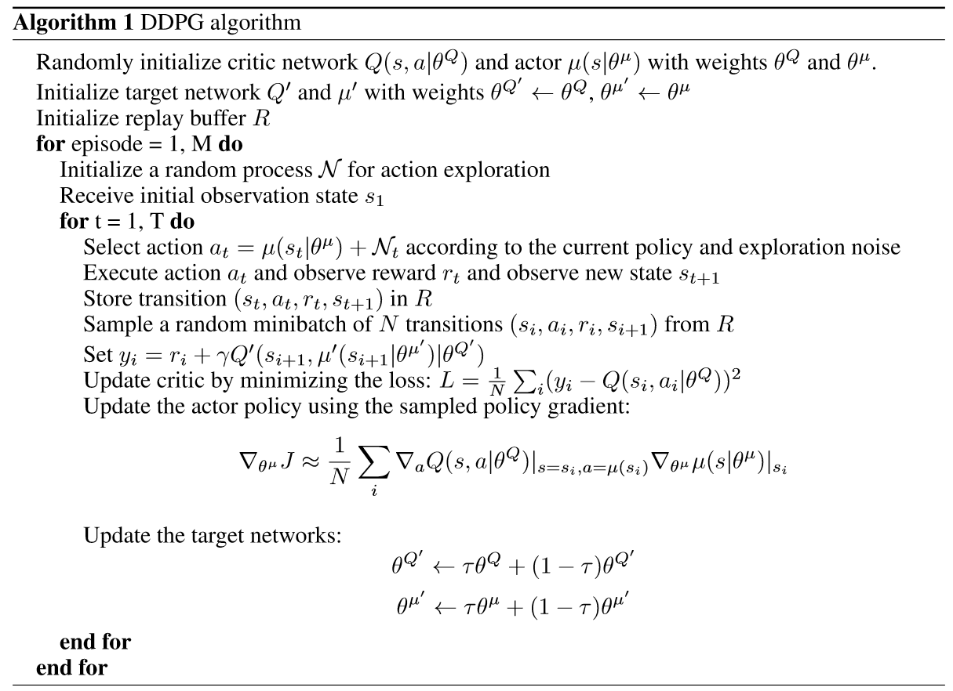



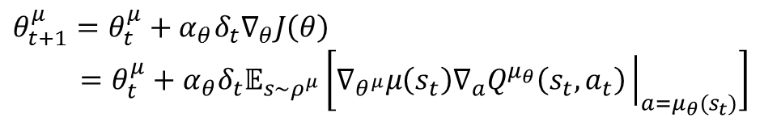

Deep-Deterministic Policy Gradient (DDPG) Algorithms
$→$Off-policy RL
$→$Reply buffer
$→$TD(0) value evaluation
Critic:
$$θ_{t+1}^{Q}=θ_{t}^{Q}+α_{w}δ_{t}∇_{w}Q^{w}(s_{t},a_{t})$$
Actor:
$$θ_{t+1}^{μ}=θ_{t}^{μ}+α_{θ}δ_{t}∇_{θ}J\left(θ\right)$$
$$=θ_{t}^{μ}+α_{θ}δ_{t}𝔼_{s\sim ρ^{μ}}\left[∇_{θ^{μ}}μ\left(s_{t}\right){∇_{a}Q}^{μ_{θ}}\left(s_{t},a_{t}\right){\left.​\right|}_{{a=μ}_{θ}(s_{t})}\right]$$

Slide 21
Deep-Deterministic Policy Gradient (DDPG) Algorithms

Slide 22
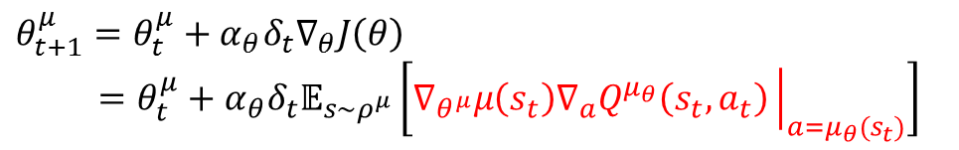
Deep-Deterministic Policy Gradient (DDPG) Algorithms
Actor:
$$θ_{t+1}^{μ}=θ_{t}^{μ}+α_{θ}δ_{t}∇_{θ}J\left(θ\right)$$
$$=θ_{t}^{μ}+α_{θ}δ_{t}𝔼_{s\sim ρ^{μ}}\left[∇_{θ^{μ}}μ\left(s_{t}\right){∇_{a}Q}^{μ_{θ}}\left(s_{t},a_{t}\right){\left.​\right|}_{{a=μ}_{θ}(s_{t})}\right]$$

Slide 23
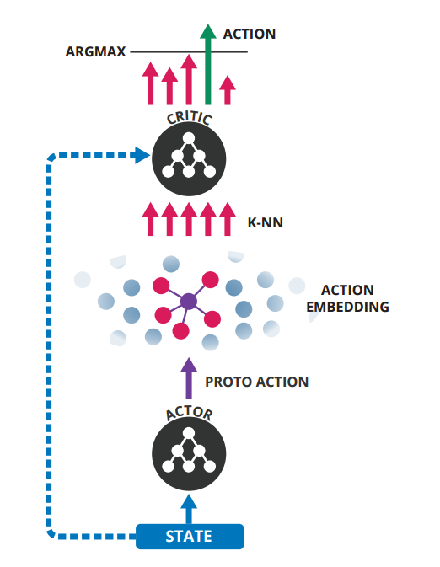
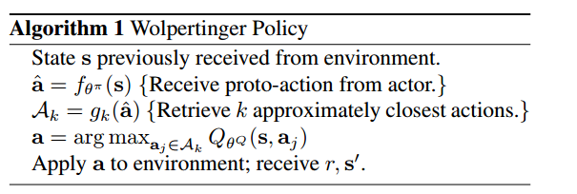
Large Discrete Action Spaces
“Deep Reinforcement Learning in Large Discrete Action Spaces”
Dulac-Arnold et al., (2016). DeepMind
leveraging prior information about the actions to embed them in a continuous space upon which the actor can generalize.
This embedding also allows the policy’s complexity to be decoupled from the cardinality of our action set.
Uses an approximate nearest neighbor search to find the set of closest discrete actions

